Slide 1
National Public Education Directorate Instructor Workshop 2023
January 2023
Notes:
This is the Instructor Workshop for 2023. Members can read the material and submit a self-attestation form, or a qualified facilitator can present the material.
We highly recommend that this workshop be presented by a qualified facilitator who has made themselves thoroughly familiar with these extensive instructor notes. The notes are intended to supplement the brief information presented on the slides. A careful reading and understanding of the notes are required to understand the concept and details of the slide. Just reading the slides is not enough. Facilitators should spend sufficient time developing their lesson plans before presenting this material. Everyone will benefit from the proper preparation and delivery of this workshop.

Slide 2
Continuous Improvement is better than delayed perfection. Mark Twain
January 2023
Notes:
What is the meaning of “continuous improvement is better than delayed perfection?” It’s a great quote to say get started. If you wait for the right time, you will always be waiting. Get started and improve on what you are doing. If you wait for perfection, you will be waiting for a long time.
Why is improvement better than perfection? Perfection is attainable in only some of our daily activities, but regular small improvements will ultimately lead to steady improvement. Keep working and allowing yourself to take small steps.

Slide 3
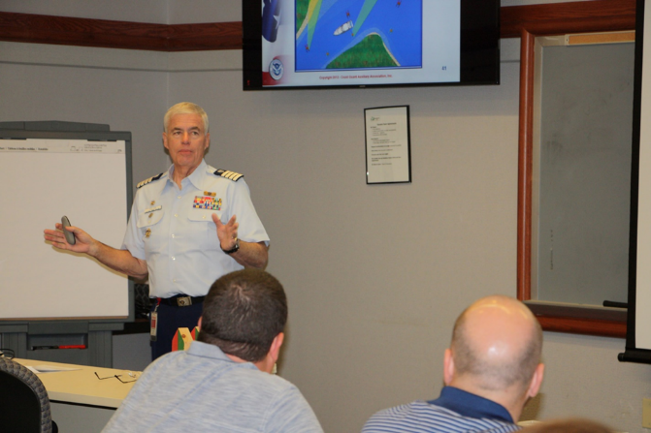
Who Should Take this Workshop?
All members involved in public education
All members involved in member training
All members mentoring new members
All members!
January 2023
Notes:
Whether we’re instructors in public education or member training, we’re involved with teaching and mentoring.
Furthermore, many flotilla members who are not instructors serve as mentors to new members, assist at classes, do vessel safety checks, and help recruit.
This workshop is for all members!

Slide 4
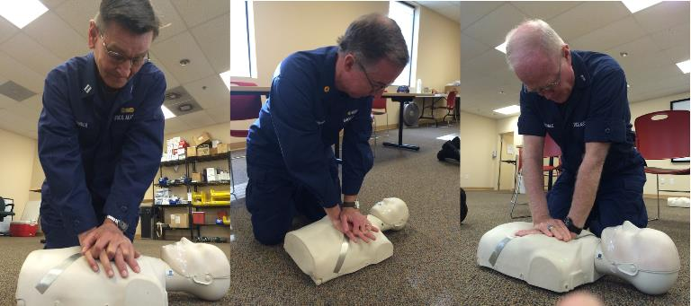
Why an Instructor Workshop?
Public Education (PE) classes are often our first contact with the public
PE classes are a source of new members
Member Training (MT) affects member satisfaction
January 2023
Notes:
The first impression most people get of us, the Auxiliary, is in a boating class. The members involved in Public Education (PE) are front-line ambassadors.
The ability to present our organization as a team of professionals largely rests on the shoulders of our instructors.
Likewise, once a new member has been recruited and joined a flotilla, the satisfaction they derive from membership is mainly proportional to the quality of the training they receive. Our member training instructors are also front-line ambassadors.
Our organization’s first impression rests largely on our instructors.
New member satisfaction = the quality of the training received.
The high quality of both PE and MT Instructors results in Recruiting and Retention!

Slide 5
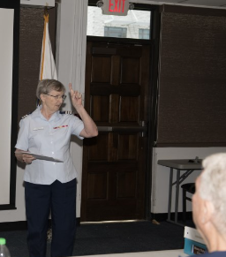
Why an Instructor Workshop?
Professional, quality instructors equal:
Better recruiting
Higher retention
Instructors need to practice their craft!
January 2023
Notes:
Our organization’s first impression rests largely on our instructors.
New member satisfaction = the quality of the training received.
The high quality of both PE and MT Instructors results in Recruiting and Retention!
Instructors need to teach, train, study, and practice constantly. While two hours of instruction are all that are required to retain certification, instructors are highly encouraged to go beyond the minimum. Proficiency and effectiveness come with practice – practice teaching students. Consider setting a personal goal of substantially increasing your instructional hours over the previous year.

Slide 6
Welcome
Key Points:
Instructor Responsibility
E-Directorate Website Navigation
Virtual Classes via Videoconferencing
Marketing PE Classes
Instructor Development 2020
Maxim Award
New/Updated AUXDATA II Codes
January 2023
Notes:
This workshop is designed to assist all members involved with Public Education and Member Training: Staff Officers for Public Education at all levels, Instructors, and their elected officers. The material in this presentation will provide the member with ways to improve class presentations and take advantage of the material on the Public Education Directorate website.
Emphasis will be on the items listed, including:
Responsibility of our Instructors when conducting classes and how to retain members through training.
E-Directorate Website Navigation – the pages have been reorganized and enhanced. The Public Education Directorate is constantly adding new material to the website. Members are encouraged to regularly check the What’s New section on the left menu of the Home Page.
Virtual Classes via Videoconferencing – this will cover the current situation relative to the offering of virtual classes.
Marketing Our Classes – this area will provide concrete suggestions for marketing our PE classes by forming flotilla Recreational Boating Safety (RBS) committees and working with our RBS partners. It also includes ways to publicize our courses.
Instructor Development 2020 – this section will introduce the ID2020 program and the related Performance Qualification Standard (PQS). To update the instructor - PE and MT programs and resources.
Maxim Award – The winners of the 2021 activity have been selected and announced. It’s now time to get the 2022 packages in.
AUXDATA II has been updated to show better what PE courses are being taught and how.

Slide 7
Welcome
Key Points:
Boat America
Spanish Language Classes
How-to for a Public Education Officer
Recertifying after the loss of certification (REYR)
Uniforms
Recruiting via PE Classes
What’s New
January 2023
Notes:
Boat America – Review of Boat America resources.
Spanish Language Classes – when reviewing boating accident and fatality statistics, it became apparent that the Hispanic and Latin population was underserved. The E-Directorate has responded with several translations.
How-to for a PE Officer – many Flotilla Staff Officers-Public Education are new to the position. This section will present an overview of resources available on the E-Directorate website.
Recertifying after REYR – if an instructor has gone REYR (Yearly Requirement Not Met), here are instructions on re-certifying.
Proper uniforms for Public Education Classes.
How to parlay the class participants into members. To look at ways to recruit from PE.
What’s New – new information on Engine Cut Off Switches (ECOS) and Fire Extinguishers.

Slide 8
E-Directorate Missions
Provide exceptional boating education to:
Reduce:
Loss of life
Personal injury
Property damage
Provide timely materials to:
Support:
Instructors
Public Education Staff Officers
January 2023
Notes:
The mission of the Public Education Directorate of the US Coast Guard Auxiliary is two-fold: to provide exceptional boating safety education to the American public to reduce loss of life, personal injury, and property damage to recreational boaters; and to deliver the highest possible quality training, resources, and timely materials in support of our flotilla instructors and public education staff officers at every level who are furnishing such boating safety education.
The Public Education Directorate is committed to helping realize those goals by reaching as many people with safe boating information as possible, especially high-risk boaters.
In addition, we have these goals:
Develop and/or maintain up-to-date and effective educational materials;
Continue to focus on the segment of the boating public most at risk Increase flotilla-taught basic boating safety education by at least 10% annually;
Provide and promote ongoing quality instructor development;
Make use of appropriate technological resources;
Adopt e-learning as a viable way to reach boaters;
Utilize e-learning to challenge and grow our instructor corps;
Partner with outside organizations where applicable to further boating education;
Continue to team with the experience and expertise of the other National Departments to provide solid programs and course content.

Slide 9
Instructor Responsibility
Self-preparation
Why is this important?
What are some ways to self-prepare?
Continue to educate yourself in areas of interest
Take advantage of our many training courses
January 2023
Notes:
We need to be reassessing our teaching techniques and lesson plans constantly.
Ask other flotilla Instructors to give you a critique of your instruction.
Take advantage of any and all training opportunities that will further your knowledge of the subjects you want to teach or mentor.

Slide 10
Instructor Responsibility
In planning the lesson
Room setup
Classroom hands-on exercises
Discussions
Example: “MOB- what would you do?”
Humor- when and how
Guest speakers or other resources
Paperwork
January 2023
Notes:
These are essential topics. These apply to both PE and MT classes.
Can everyone in the room see the screen or whiteboard?
The instructor needs to walk around the room while setting up and make sure.
Is the room set up to make facilitation and learning more accessible?
Many feel that “U” shaped table arrangements are better suited for discussions than the traditional “classroom” style of tables in rows.
Can the instructor freely circulate around the room and interact with the class?
How can you make the material in the class as close to the participant’s real-life boating experiences as possible?
Use hands-on exercises that get the class involved in doing.
Get the class involved through discussion. There is a wealth of experience within every group; a good instructor will realize and capitalize on that.
Humor as an icebreaker works well. Use it tastefully and never at anyone in the class’s expense.
Use other “subject matter experts.” Firefighters, EMTs, Harbor Patrol, Park Rangers, sailing instructors, and others are excellent resources who can bring a depth of knowledge to the session.
You’ve heard the expression, “if it’s not in AUXDATA II, it didn’t happen.” Send the appropriate 7030s to your FSO-IS to record your hard work in member training or PE. Even better, get familiar with AUXDATA II and complete the entries directly yourself.

Slide 11
Culture of Safety
Review the Classroom Safety Checklist on the E-Directorate Website in What’s New.
http://edept.cgaux.org/pdf/Classroom%20Safety%20Checklist.pdf
January 2023
Notes:
The E-Directorate takes the Coast Guard Auxiliary’s emphasis on safety very seriously. To emphasize the point, we developed an Infographic to cover the classroom checklist. Find a copy at Classroom Safety Infographic (cgaux.org):
http://edept.cgaux.org/pdf/Classroom%20Safety%20Checklist.pdf

Slide 12
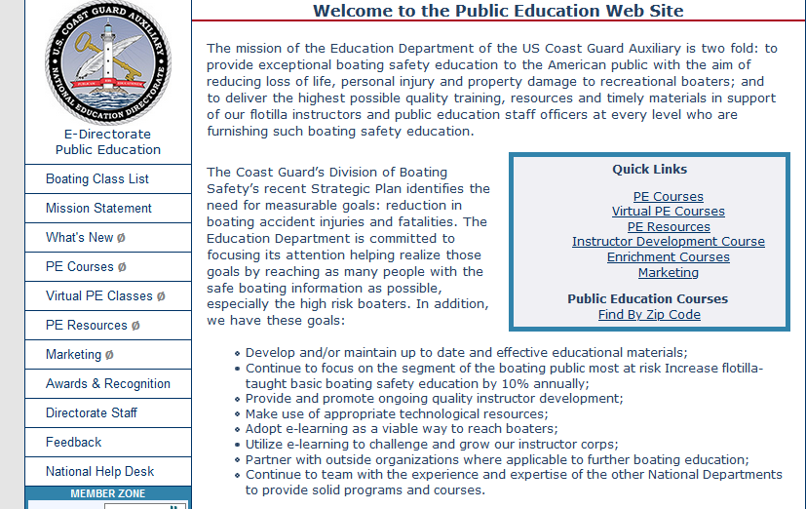
Website Navigation
Reordered menu
Intuitive navigation
Fewer clicks
Archiving of old material
Frequent material updates
http://wow.uscgaux.info/content.php?unit=e-dept
January 2023
Notes:
Since public education is such a dynamic area, there are constant additions and changes made to the website. It is worthwhile for the Instructor and Staff Officer to check the site frequently – especially the “What’s New” section.
The E-Directorate website refresh and reorganization were completed in 2021 and is constantly updated. Reorder of menu choices enables users to find what they need more intuitively and with fewer clicks. Older material has been archived.
Access the E-Directorate website at: http://wow.uscgaux.info/content.php?unit=e-dept

Slide 13
Web Resources to Improve Your Classes
Post your PE classes
On the 7023 Form for Course Finder
Your flotilla web page
Look for useful websites, i.e., weather
E-Directorate Resources
Watersports Videos Water Sports Industry Association | Voice of the Water Sports Industry (wsia.net)
US Power Squadron (America’s Boating Club) videos on America’s Boating Channel America's Boating Channel - YouTube
January 2023
Notes:
More and more people use the Internet to find what they want or need. They won’t find us if we’re not there.
In addition, the Internet is rich with resources we can use in PE or member training.
The 7023 Form can be found on the Forms Warehouse on the main Coast Guard Auxiliary page at cgaux.org.
The Water Sports Industry Association website is full of good, free videos at Water Sports Industry Association | Voice of the Water Sports Industry (wsia.net).
The United States Power Squadron / America’s Boating Club offers numerous videos that would be effective for classroom presentation on America's Boating Channel – YouTube.
The videos available from the Water Sports Industry Association and the Power Squadron were produced from grants administered by the US Coast Guard. They have been vetted by the Coast Guard, are in the public domain, and are free for us to use. Instructors and Public Education Officers should give attribution whenever they use one of the videos, but no permission or notification is needed.

Slide 14
Virtual Classes via Videoconferencing
Visit the E-Directorate Virtual PE Classes Web Pages
In Member Zone protected pages
Describes:
Value of virtual classes
How-to of virtual classes
Marketing of virtual classes
http://wow.uscgaux.info/content.php?unit=E-DEPT&category=virtual-pe-classes
January 2023
Notes:
The workshop attendee is encouraged to check out the information and resources available in the Virtual PE Classes menu on the left side of the page. The information is protected from the public by being in the member zone. Log in with the same login you use for most of your Auxiliary areas.
With the advent of the COVID-19 pandemic in 2020 and the subsequent shutdown of Auxiliary missions, the E-Directorate quickly embraced virtual technology to enable the members to continue instructing public education classes within the Recreational Boating Safety (RBS) mission area.
Even though most areas have opened for in-person classes, many flotillas are still offering their Public Education classes and Member Training classes via videoconferencing platforms like Zoom. This removes the travel restrictions and opens our courses to students throughout our state and even beyond.
Before offering virtual Public Education classes, check with your district’s DSO-PE to ensure your state has approved the virtual delivery of Public Education.
Access this information at: http://wow.uscgaux.info/content.php?unit=E-DEPT&category=virtual-pe-classes

Slide 15
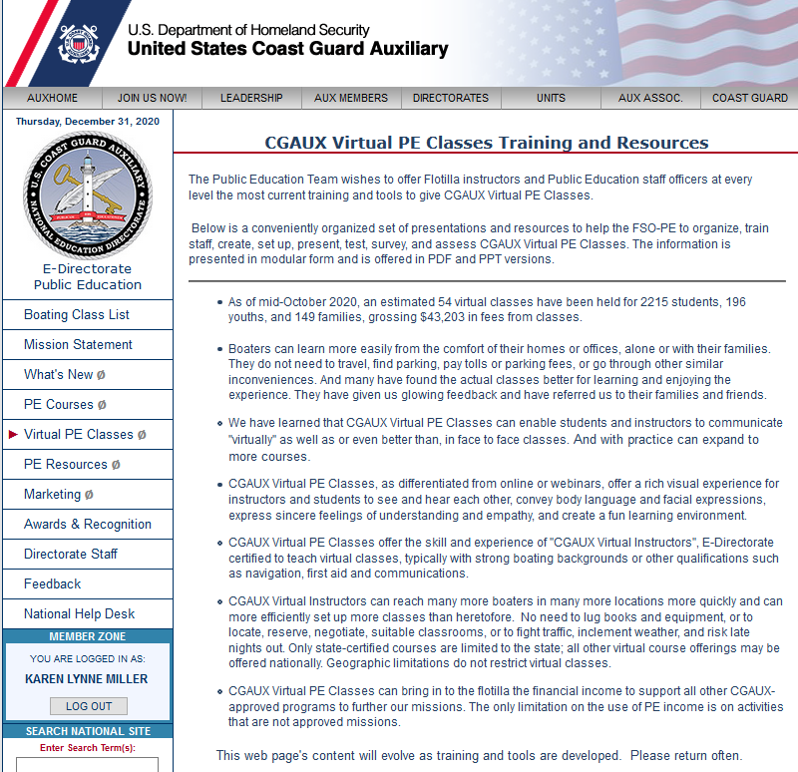
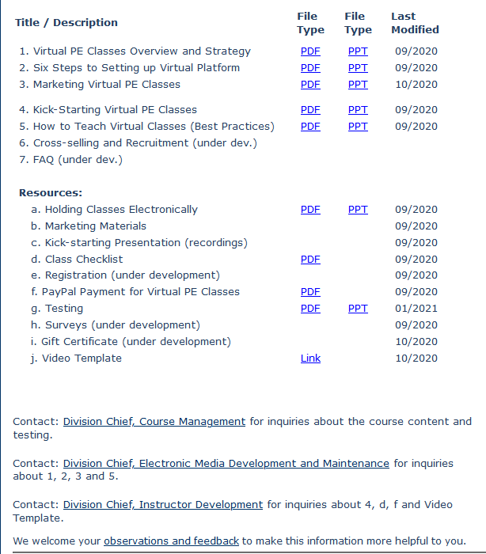
Virtual Classes via Videoconferencing
Visit the E-Directorate Virtual PE Classes Web Page
http://wow.uscgaux.info/content.php?unit=E-DEPT&category=virtual-pe-classes
January 2023
Notes:
The virtual PE web page contains valuable information on the rationale for offering classes online via videoconferencing. In addition, there are numerous tools to help the FSOs-PE and instructors set up the virtual platform, kick-start the whole process of offering virtual classes, collect class fees using PayPal, conduct “proctored” testing in a virtual environment, and market the classes even during difficult times, such as storms and pandemics.
Even as we open our classes more and more to in-person sessions, FSOs-PE may consider continuing to offer some of their courses via videoconferencing. With almost three years of experience, many flotillas are seeing more students enrolling in virtual classes than they had in face-to-face classes. The virtual course eliminates the commuting requirements for the students and instructors and vastly opens the area from which we can attract students.
Several flotillas reported students from neighboring states signed up for their classes. Many southern US flotillas experienced students enrolled in their virtual classes from northern states during the warmer months, preparing them for their winter travel to the southern states.
Students now connect virtually from across the state(s) and are no longer limited to driving distance. Families are taking virtual classes together from the comfort of their homes. And students enjoy the interaction of seeing each other and the instructors on the video screen.
Numerous flotillas have reported that their classes, averaging eight to ten students, have more than doubled when offered virtually. This increase in student quantity often was attributed to the ease that students experience by being able to learn in the comfort of their homes. Several flotillas were also limited in the number of students they could accommodate in their classrooms, a concern negated by virtual delivery.
Access this area of the website at:
http://wow.uscgaux.info/content.php?unit=E-DEPT&category=virtual-pe-classes

Slide 16
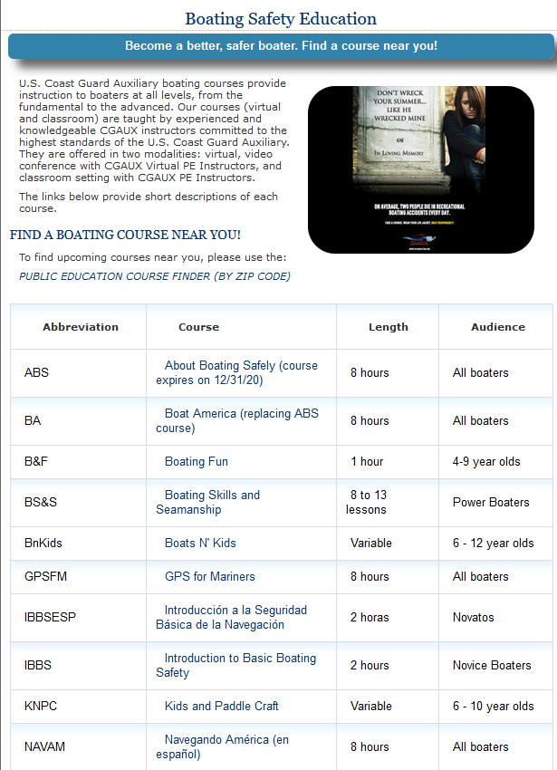
Course Finder
Refreshed/Re-organized Course Finder
www.cgaux.org/boatinged/class_finder/index.php
January 2023
Notes:
Working with the C-Directorate, we completely updated and reorganized the Course Finder to include certificate courses and seminars. This will allow flotillas to advertise all Auxiliary classes they offer. It is now possible to advertise that a class is virtual and not an in-person classroom course.
This site is updated via the Forms Warehouse, ANSC Form 7023. The FSO-PE or other officer should populate their classes for the year as soon as possible. It’s essentially free advertising. Many individual states link right back to this page when referring boaters to classes.
The class finder website is at:
www.cgaux.org/boatinged/class_finder/index.php

Slide 17
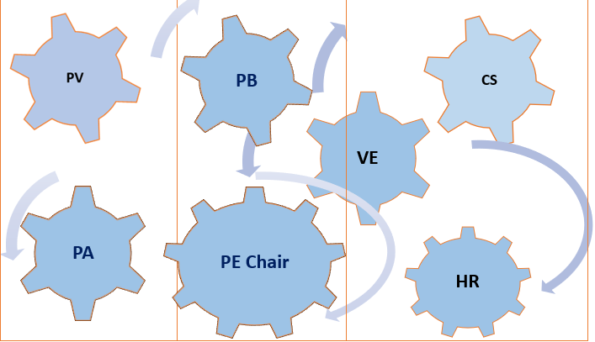
Marketing Our Classes RBS Committees
A smoothly functioning team of flotilla staff officers can achieve significant results with coordinated teamwork
January 2023
Notes:
Referrals are traditionally the best source of new students. The best time to learn about our classes is when boaters make a boating-related decision. Many service providers can benefit their clients by recommending CGAUX PE Classes.
Building relationships with those vendors can pay off with a steady stream of referrals. And if the relationship is cultivated, it keeps giving and builds upon itself year after year. Formal and informal referrals can be repetitive, cumulative, low-cost, and very rewarding.
A smoothly functioning team of flotilla staff officers can achieve significant results with coordinated teamwork. A straightforward website, a rich calendar with frequent multiple offerings, active Facebook friends, a targeted video, special interest articles with local community papers, local TV interviews, local radio, boating, fishing and hunting programs, and public service ads all offer ongoing opportunities. And above all, a frictionless signup procedure where a knowledgeable Auxiliarist answers all inquiries personally and quickly, enrolling the inquiring boater seamlessly.
The Public Education Directorate webpage has several good presentations on marketing your PE programs – both Outbound (i.e., PA) and Inbound (i.e., referrals).

Slide 18
Work With our VE/RBSPV Partners
Vessel Examiners and Program Visitors
Partners in recreational boating safety
Our common mission?
“Prevention through education”
How can VEs/PVs help?
Distribute class schedules at VSCs
Share schedules with their partners
Share VSC schedules with your classes, too!
January 2023
Notes:
Vessel Examiners and Program Visitors
Our partners in recreational boating safety
Our common mission?
“Prevention through education”
How will VEs/PVs help?
Distribute class schedules at Vessel Safety Checks (VSCs)
Share schedules with boat dealers and more
Make sure to share vessel safety check schedules in the PE classes, too – especially after covering legal and safety chapters.

Slide 19
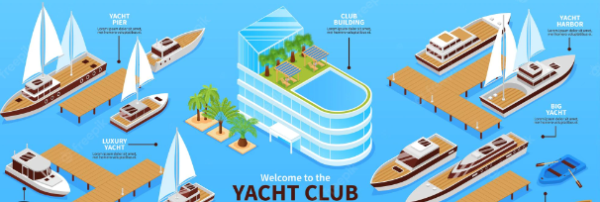
Marketing Our Classes Ways to Promote PE
Contact the local court
Liaison with local insurance agents
Use “bite-sized” seminar courses
Think “non-traditional”
January 2023
Notes:
Contact the local court:
Offer Boat America or Boating Skills and Seamanship for boating infractions.
Liaison with local insurance agents:
Ask them to share your Public Education (PE) class schedule with clients.
Use “bite-sized” courses:
Mini-classes for clubs and schools.
Seminar courses work well for yacht and fishing clubs.
Sign them up for a full class on the spot!
Think “non-traditional:”
Hunting and fishing clubs.
Paddlesports clubs.
Public Works departments.
The E-Directorate offers numerous documents to assist the flotillas in marketing their courses. Go to
http://wow.uscgaux.info/content.php?unit=E-DEPT&category=marketing for access to these documents behind the Member Zone firewall.

Slide 20
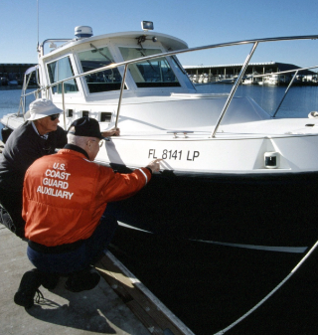
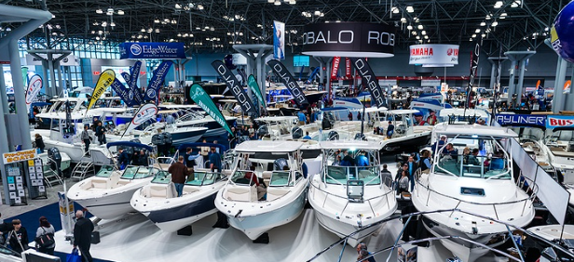
Marketing Our Classes Ways to Promote PE
During VSCs!
RBS Program Visits
Conduct a media blitz
Tell the world - use the Web
Talk it up!
Sign them up at boat shows
January 2023
Notes:
During Vessel Safety Checks (VSCs):
Go with the Vessel Examiner (VE) or provide schedules.
Recreational Boating Safety (RBS) Program Visits:
Go with the Program Visitor (PV) or provide schedules.
Conduct a media blitz:
The Flotilla Staff Officer-Public Affairs (FSO-PA) can help.
Tell the world - use the Web:
Post your schedule on your website and keep it current.
Social Media presence
Fill out the 7023 form for all courses offered
Talk it up:
Tell everyone you meet.
Sign them up at boat shows:
Don’t just hand out schedules.
Sign them up on the spot! Use your laptop to key their information while they wait!
Collect course fees and give receipts.
Consider a raffle for a free PE class.
More people will enter their names.
Use as contacts later for classes.
When promoting PE classes, making the registration and course payment as frictionless and seamless as possible is essential. There are numerous programs/applications that flotillas have used successfully. Some of these are:
Eventbrite
SignUpGenius
Google Forms
PayPal
Square
Collecting payment up front greatly enhances the probability the students will attend the class. Make this a good customer service experience for the student if they have a conflict and must change dates or give them a refund if that is the right thing to do. Approach the experience from the student’s point of view when you set up your system to handle payments and registration. Make it as friction-free and easy as possible.
Note: The E-Directorate has detailed instructions to help a flotilla set up payments via PayPal at:
http://wow.uscgaux.info/content.php?unit=E-DEPT&category=virtual-pe-classes

Slide 21
Instructor Development 2020
Updated material and exam
Introduced in January 2020
New instruction techniques
Emphasis on learning vis-à-vis memorization
Includes:
Use of electronic media
Compliance with ADA
Value and use of lesson plans
http://wow.uscgaux.info/content.php?unit=E-DEPT&category=2020-instructor-dev
January 2023
Notes:
Before this updated program, the Instructor Development course had not been modernized since 2007. A lot happened during that time to help the Auxiliary instructor perfect their presentation methods. This course – ID2020 – does that. This course is recommended for initial qualification and as a refresher for seasoned instructors.
The course has eight units emphasizing learning the information through practical application rather than memorizing theoretical instructor material. It focuses on the latest and most effective methods for teaching, facilitation, multi-media, and demonstration of skills.
The units include:
14 instructor competencies
Lesson planning
Using Media Effectively
Effective Communications Skills
Handling Difficult situations
Accommodating all students
Learning with Electronic Technologies
There are also several appendices:
Instructional equipment
Presentation tips and best practices
The performance qualification standard
Access the ID2020 material at:
http://wow.uscgaux.info/content.php?unit=E-DEPT&category=2020-instructor-dev

Slide 22
Instructor Development 2020
Who will participate?
All newly qualifying instructors
Today’s instructors - as mentors
All ITs should review the new material
All ITs are encouraged to take the course!
Practice and hone our skills
January 2023
Notes:
It is highly recommended that even seasoned instructors review the ID2020 Student Study Guide and then go to NTC and take the new exam. There’s a lot to be learned this way.
The new instructor qualification course is based on demonstrating skills in instructing. This will allow the instructor candidate ample time with a mentor to develop their skills.
The focus of ID2020 is facilitating an effective learning environment. Mentor instructors will have check sheets of tasks the trainee needs to accomplish. Both mentor and trainee will benefit from the course and the time spent practicing the art of teaching.

Slide 23
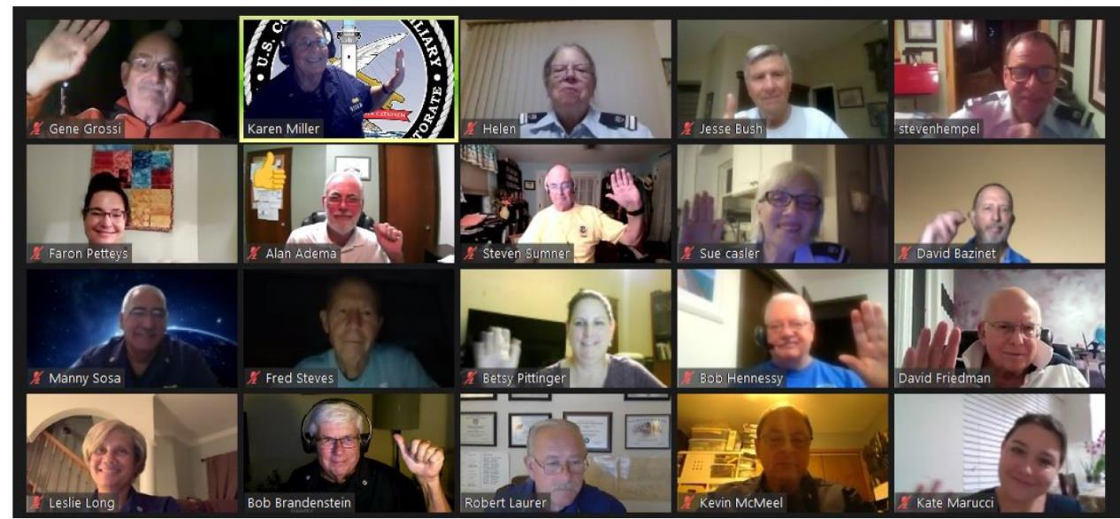
Instructor Development 2020
Nation-wide Virtual ID2020 Class
January 2023
Notes:
The completion of Instructor Development 2020 prepares new instructors for public education and qualifies them for member training to help address an ever-shrinking cadre of instructors.
Uniquely, the E Directorate conducted a series of virtual classes to qualify new instructors online. The students completed all Professional Qualification Standard (PQS) tasks except for the final 2-hour presentation, which they achieved with their own flotillas. The final sign-offs and certifications were conducted at the flotilla level. The upside of completing their certifications in a virtual environment ensured that each student was comfortable and competent in using this technology to teach public education and member training.
Feedback received has been outstanding, with no negative comments. This method could work very well locally – in a district, division, or flotilla.
For 2023 and beyond, the E-Directorate has set up a branch of instructors who will be offering ID2020 virtually at least four times a year. In addition, they will train seasoned instructors to present ID2020 locally within their district, division, and flotilla.

Slide 24
Maxim Award
Designed to:
Motivate instructors
To achieve excellence in instruction
Develop innovative methods and training aids
Increase mentorship
Nominated by flotilla no later than February 28th
http://wow.uscgaux.info/content.php?unit=E-DEPT&category=maxim-award
January 2023
Notes:
The Commodore Daniel Maxim Award for Excellence in Education was established to motivate and inspire the entire Instructor cadre to reach beyond the comfortable or ordinary to achieve the extraordinary. Some of the goals of the Award are to increase the diversity of courses offered by flotillas and additional numbers of classes offered; to improve Public Education and Member Training Instructor effectiveness and performance; to improve mentorship of newer or lesser experienced Instructors; to develop new and innovative teaching methods and techniques; to develop new and innovative teaching aids.
Visit the E-Directorate website for examples of past winners’ submission packages and award templates for division and flotilla candidates. Updated guidance on the Maxim Award streamlining the process was recently made for the 2022 nominees. The details can be found on the website under the Maxim Award.
A best practice that has been suggested is that a flotilla compile a list of their best candidate(s) with bullet points of their assets as instructors. Work with the DSO-PE to see about fleshing out the package for actual development into an award submission.
The Commodore Daniel Maxim Award for Excellence in Education material is found at:
http://wow.uscgaux.info/content.php?unit=E-DEPT&category=maxim-award

Slide 25
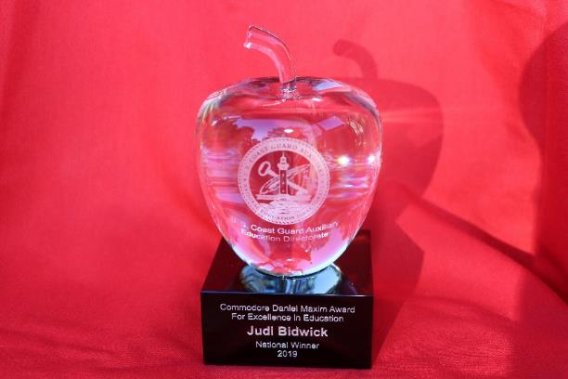
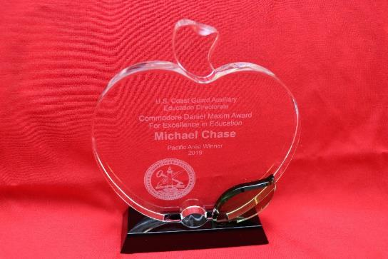
Maxim Award
National Prize Winner + Auxiliary Commendation Medal
Area Prize Winner + Auxiliary Achievement Medal
January 2023
Notes:
Flotillas should consider assembling a team now to begin accumulating supporting documentation for the number of courses taught, the number of graduates, the variety of courses taught, and all other data and testimonials deemed pertinent to preparing the nominee package. Flotilla nomination packages will be due on February 28 to their DSO-PE, so now is the time to start to avoid the last-minute rush, as that date will be here before we know it!
The Public Education Directorate recognizes that 2022 was an incredibly challenging year for most Auxiliarists because of continuing COVID-19 precautions. However, many flotillas openly embraced the option of offering virtual online classes via videoconferencing, and nomination packages should include how the nominee overcame the obstacles of using new technology for course presentation and what successes s/he experienced.
Go to http://wow.uscgaux.info/content.php?unit=E-DEPT&category=maxim-award for more information on the Commodore Daniel Maxim Award for Excellence in Education.
NOTE: Schedule
Package from flotillas to DSO-PE: 28Feb.
District selected package to Dir-E and Dir-Ed: 30Apr.
NOTE: Eligibility
All instructors in the CG Auxiliary are eligible if nominated for the Maxim Award except a prior National Prize Winner or a member of the Public Education Directorate.

Slide 26
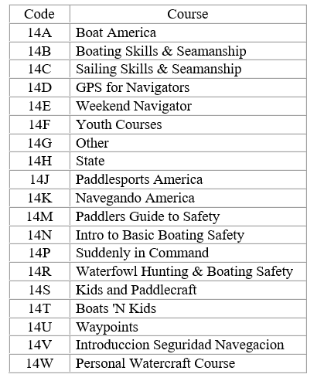
New AUXDATA II Codes
AUXDATA II Public Education Codes Updated
Additional courses added
Checkbox for virtual classes
January 2023
Notes:
The following mission activity code descriptions have been updated to clarify the reporting of efforts related to the Auxiliary Public Education mission:
14A Boat America
14B Boating Skills & Seamanship
14C Sailing Skills & Seamanship
14D GPS for Navigators
14E Weekend Navigator
14F Youth Courses
14G Other
14H State
14J Paddlesports America
14K Navegando America
14M Paddlers Guide to Safety
14N Intro to Basic Boating Safety
14P Suddenly in Command
14R Waterfowl Hunting & Boating Safety
14S Kids and Paddlecraft
14T Boats 'N Kids
14U Waypoints
14V Introduccion Seguridad Navegacion
14W Personal Watercraft Course

Slide 27
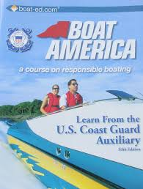
Boat America
Boat America offered as NASBLA approved certificate course
Order from AUXCEN (Shop Auxiliary)
https://auxcen.com/public-education/
Find the slides with instructor notes and the state supplement slides at:
http://wow.uscgaux.info/content.php?unit=E-DEPT&category=nasbla-courses
January 2023
Notes:
The E-Directorate encourages flotillas to embrace Boat America. The slides and instructor notes are included on the E-Directorate website under a Member Zone-protected section titled PE Courses. There is also a DVD available from AUXCEN that includes numerous videos to incorporate into the course presentation.
The state supplements are also on the website for Boat America and Boating Skills and Seamanship, thus ensuring ease of use for flotillas teaching these certificate courses. Whenever a state requests changes to its slides and/or test, the Division Chief for Course Development will implement the updates and then notify the appropriate DSO-PE, who should, in turn, pass the information down to the SOs-PE and FSOs-PE.
Flotillas are encouraged to add to the slides any appropriate material that will enhance the presentation and make it applicable to the local area. Remember, you can’t delete material but can add appropriate items to explain a point better, such as additional slides, videos, etc.
This course works well for both in-person delivery and via virtual platforms.
Find the slides with instructor notes and the state supplement slides at:
http://wow.uscgaux.info/content.php?unit=E-DEPT&category=nasbla-courses

Slide 28
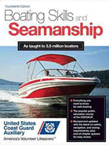
Books and Materials
Boat America and Boating Skills and Seamanship books may be purchased only from AUXCEN (Shop Auxiliary)
https://auxcen.com/public-education/
ANSC has a variety of free supplemental materials to distribute to class members.
http://cgaux.org/members/ANSC_Catalog_Oct22.pdf
January 2023
Notes:
The Auxiliary Manual, Chapter 2, section B.13.d, states: The Coast Guard Auxiliary Association, Incorporated (CGAuxA, Inc.) develops and publishes and/or acquires and distributes course materials and examinations. These materials are to be used to conduct all Auxiliary PE
courses. …Course materials are only purchased from Coast Guard Auxiliary district material centers or the Auxiliary Center (AUXCEN). Course books, appropriate tests, marking templates, and evaluation forms, are sold and shipped according to the current pricing available on the AUXCEN website.
Auxiliary National Supply Center: ANSC supplies Auxiliary units with a wide variety of training, recognition, administration, and program support materials. These materials include
publications, forms, manuals, pamphlets, posters, CDs, and the initial issue of Auxiliary medals and awards.
Numerous brochures that are appropriate to supplement the course book and class information are available from ANSC at no charge to the flotilla. The current ANSC catalog lists all the materials available to the public education instructor. The materials officer usually does the ordering.
You can access AUXCEN at: https://auxcen.com/public-education/
You can access ANSC at: http://cgaux.org/members/ANSC_Catalog_Oct22.pdf

Slide 29
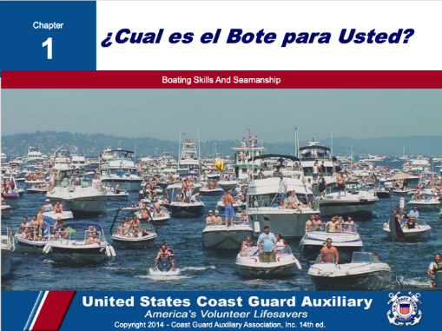
Spanish Language Classes
Spanish-speaking boaters:
Represent fast-growing boat buyers
Emerging market of first-time boat buyers
Under-served boating education market
http://wow.uscgaux.info/content.php?unit=E-DEPT&category=pe-courses
January 2023
Notes:
A 2017 study published by the National Marine Manufacturers Association, Recreational Boating & Fishing Foundation, and Discover Boating showed that Spanish-speaking boaters represent a fast-growing, emerging market of first-time boat buyers. In response, the E-Directorate is rolling out a series of courses translated into Spanish. All supplemental material – PowerPoint Slides, Instructor Notes, and Final Exams are all in Spanish; the textbooks will remain in English.
These Spanish language courses can be found on the Public Education website on the left menu under PE Courses (protected by the Member Zone password). There are both National Association of State Boating Law Administrators (NASBLA) courses and Seminar Courses in that area.
Boat America
Boating Skills and Seamanship
Introduction to Basic Boating Safety
The Spanish language courses are available at:
http://wow.uscgaux.info/content.php?unit=E-DEPT&category=pe-courses

Slide 30
Spanish Language Classes
All slides, instructor notes, and exams in Spanish - books are offered only in English
January 2023
Notes:
A team of bi-lingual CG Auxiliary members converted all Boat America and Boating Skills and Seamanship slides, instructor notes, and examinations into Spanish. This effort is intended to help educate Hispanic community members about safe boating in their native language.

Slide 31
I’m the Flotilla Staff Officer-Public Education, Now What?
Available on the E-Directorate Website
January 2023
Notes:
One of our most important missions is to offer safe boating classes to the recreational boating public. This new training course is designed for both the new Flotilla Staff Officer-Public Education (known as FSO-PE) and for those returning to the position who want to learn best practices.
Whether you volunteered for this important flotilla staff position or had left the room and were “voluntold” upon your return, the FSO-PE position is critical to the Coast Guard Auxiliary’s Recreational Boating Safety mission and the flotilla’s finances.
The FSO-PE position can be a pathway to even more responsible positions. Once a member has mastered the Flotilla Position, there’s the Division Staff Officer, Assistant District Staff Officer, and even District Staff Officer. Each position is a learning experience and can prepare the member to advance to more responsibility.

Slide 32
I’m the Flotilla Staff Officer-Public Education, Now What?
General FSO-PE Job Description
FSO-PE - Public Education: Exercise staff responsibility and supervision over all matters pertaining to the public education program, which includes the scheduling, organization and conduct of flotilla public education activities; and keep flotilla members informed of all developments in the program. Unless otherwise directed, you are to schedule qualified Auxiliarists to perform specific activities in support of the public education program. The schedule must include a specified time and place for the activity. Maintain close liaison with the Division Public Education Staff Officer (SO-PE) in order to implement the public education programs established for nation-wide, district-wide and division-wide use. Coordinate and cooperate with the Flotilla Member Training Officer (FSO-MT) to increase the number of qualified instructors. Maintain a close contact with flotilla instructors to encourage increased activity, and maintenance of uniformly high standards. Forward to the SO-PE such methods, training aid, course materials, or other educational tools developed within the flotilla that may have division-wide application.
January 2023
Notes:
As the FSO-PE you:
Supervise and schedule qualified Auxiliarists to perform specific activities in support of the Public Education Program.
In close coordination with the FSO-PA, plan, organize and direct programs and activities to promote and publicize boating safety and Auxiliary Public Education Courses.
Ensure that the Human Resources Staff Officer is given time to discuss the Auxiliary and Auxiliary membership in every public education course.
Maintain close liaison with the Division PE Officer to implement the public education programs established for nationwide, district, and division use.
Coordinate and cooperate with the FSO-MT to increase the number of qualified instructors.
Maintain close contact with flotilla instructors to encourage increased activity and maintain uniformly high standards.
Forward to the Division PE such methods, training aids, course materials, or other educational tools developed within the flotilla that may have division-wide applications.
Encourage and assist in developing training aids for use by flotilla instructors.
Maintain familiarity with the course content and instructional requirements of all approved public education courses.
Ensure that instructors have coordinated in advance to have necessary training aids, screens, projectors, and handouts on hand before class. Report as required to the Flotilla Vice Commander and Division Public Education Officer all progress and activities in the field of public education.

Slide 33
Instructor Currency Maintenance
2020 COVID-19 “shutdown” – all instructor currency maintenance waived
2023 Instructors must meet standard currency maintenance requirements
Virtual
In-person, where permitted
Missed 2022 Required Workshop?
Missed 2022 Required Instructor Hours?
January 2023
Notes:
In 2020, following the organization-wide shutdown, the Chief Director’s office decided that requiring instructors to maintain their currency maintenance that year was impractical. As a result, they waived the requirements.
The current policy was that instructors had to maintain currency in 2022. This includes:
Two hours as a lead instructor or;
Four hours as a non-lead instructor or;
A combination of both;
Plus completion of the required workshop.
If a member failed to complete the workshop or the required hours as lead and/or non-lead instructor in 2022, they became REYR – required yearly task not met – for 2023 and need to make up the deficit during 2023 to recertify as an instructor.
If the member still needs to complete the required 2022 workshop, they must still review it and sign the self-attestation form. This form is then submitted to the Information Services Officer for entry into AUXDATA II. Once it is entered in AUXDATA II, the Flotilla Commander needs to notify their district DIRAUX according to district policy to re-certify the member as an instructor.
If the member failed to instruct for two hours as lead or four hours as non-lead, or a combination of both, they need to complete the missing hours in 2023 as a trainee and have those hours entered into AUXDATA II. Once it is entered in AUXDATA II, the Flotilla Commander needs to notify their district DIRAUX according to district policy to re-certify the member as an instructor.
NOTE: This all assumes the member is current in Core Training.

Slide 34
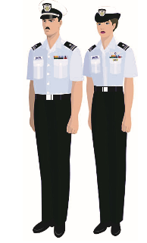
Uniforms
The Auxiliary Manual, Chapter 10, Section A.4 lists uniforms appropriate for the classroom. They include:
Tropical Blue
Winter Dress Blue
Service Dress Blue
Auxiliary Blue Blazer Outfit
See the uniform information available in the Human Resources Website under Auxiliary Uniforms
January 2023
Notes:
The Auxiliary Manual, Chapter 10, describes the uniforms appropriate for the classroom.
There is an excellent uniform presentation on the Human Resources website under Auxiliary Uniforms.

Slide 35
Uniforms – Alternative Work Uniform (AWU)
The Chief Director’s Standard Operating Procedure - September 2021.
Authorizes the AWU for PE Classes
Available on the Chief Director’s web page under SOPs.
January 2023
Notes:
The SOP states that Auxiliarists who participate in activities that often involve multiple Auxiliarists (e.g., public education classes; boat crews; aircrews) may wear the ODU (with or without operations polo shirt), the CG-U, or the Auxiliary Work Uniform (AWU).
It further states: The AWU is authorized to be worn as an alternative work uniform whenever the ODU or CG-U is authorized to be worn. This includes authorization to be worn to instruct virtual and in-person public education classes, perform boating safety partner visits, and for public outreach events (e.g., boating safety booths at boat shows; public outreach information tables at National Safe Boating Week events). The AWU is specifically not authorized to be worn for ceremonial occasions (e.g., as part of a color guard; or in parade formation).

Slide 36
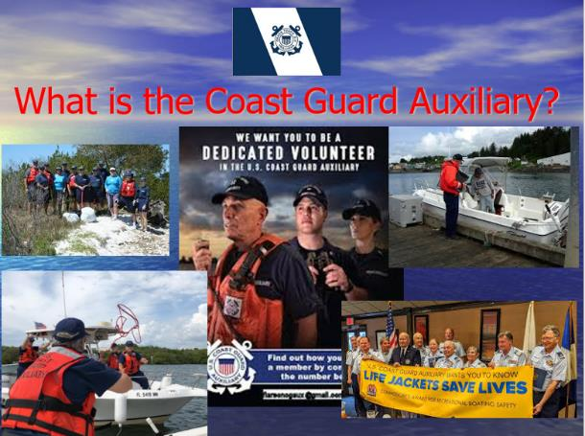
Recruiting via PE
Invitations to meetings/events
Plenty of handouts
Show common interests
Diverse and relevant
Actively mention your flotilla needs
January 2023
Notes:
Our Public Education classes can be very effective recruiting opportunities. Here are some suggestions:
Invitations to meetings/events. Getting them involved in social and mission activities gives them a front-row seat to who we are and what we do. Meetings are often boring to those outside and even sometimes to those inside the organization (this is a topic for flotilla leadership, as well).
Invite the students from every class.
Offer meetings with the Flotilla Staff Officer-Human Resources (FSO-HR) and other Flotilla Staff Officers.
Distribute plenty of handouts to the students.
Showcase various Auxiliary missions.
Show common interests.
Instructors have other interests too.
Build rapport with students.
Diverse and relevant.
The Auxiliary has a place for personal growth.
Actively mention your flotilla needs.
Not just boats- finance, computer skills, etc.

Slide 37
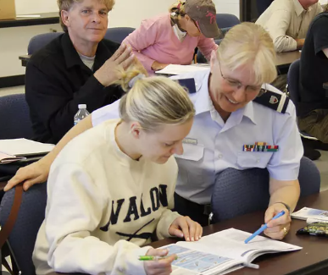
Recruiting via PE
Be approachable
Talk to students, not to each other
All recruiting is local!
Work in local pictures or anecdotes
The Auxiliary message, every time!
January 2023
Notes:
Be approachable.
Set the mood and establish rapport with students when they arrive in classroom. Engage in conversation to find out about them one-on-one. Don’t wait for class introductions. You want to break down barriers that will allow you to have two-way communication once the class begins.
Spend as much time as you can one-on-one with students rather than just using lectures. Use your class aides to assist whenever possible – be a team.
Walk around the room, don’t remain behind the podium.
During breaks, remain available for students to ask questions.
Ask students about their boats, boating experience, and boating mishaps.
Talk to students, not to each other.
Instructor cliques scream – “don’t bother talking to me – you are not part of my world.” Talk up our missions to them individually.
Whenever possible, instructors should make themselves available to the students and avoid congregating in groups of other Auxiliarists.
Avoid “inside jokes” and “acronym lingo” when having discussions with students. Always use plain English – use “life jackets” and not “PFDs.”
All recruiting is local!
We have no “National” members.
What does your flotilla need?
Work in local pictures or anecdotes.
The Auxiliary message, every time!
Work recruiting topics into every session.
Make recruiting part of the lesson plan.
Deliver benefits of membership constantly.
Show your enthusiasm for what you do.
Showcase a local event/experience every class.
If you are not having fun presenting the class, it will show and destroy the image you are trying to create. Remain positive and highlight successes of your flotilla, division, or district.

Slide 38
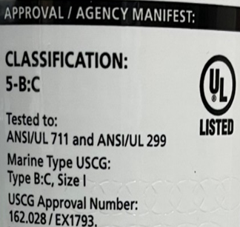
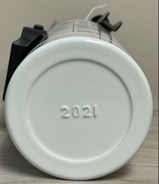
New Material to Cover in Class
Federal Law Change Effective: April 20, 2022 Fire Extinguisher Expiration Dates
January 2023
Notes:
If a fire extinguisher has a date of manufacture stamped on the bottle (for example, “05” means 2005) and is older than 12 years old, the extinguisher is considered expired and must be removed from service. Look for wording on the bottle stating, “This product must be removed from service within 12 years after the date of manufacturing.”
All recreational boats are required to carry fire extinguishers if they have permanently installed fuel tank(s) or have spaces capable of trapping fumes, such as a boat with:
a. a closed compartment under thwarts and seats wherein portable fuel tanks may be stored;
b. double bottoms not sealed to the hull or not completely filled with flotation material;
c. closed living spaces;
d. closed stowage compartments in which combustible or flammable materials are stowed.

Slide 39
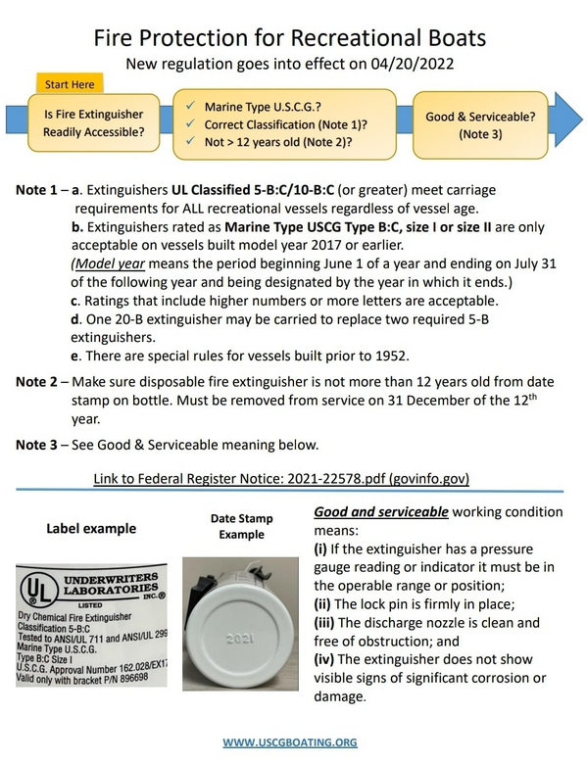
Fire Extinguishers
Excellent FAQ at:
https://bit.ly/3Io9v5J
January 2023
Notes:
There is an excellent explanation of the new law and frequently asked questions available at:
https://bit.ly/3Io9v5J.

Slide 40
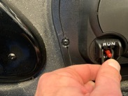
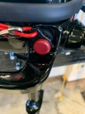
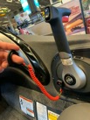
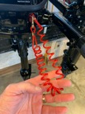
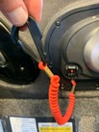
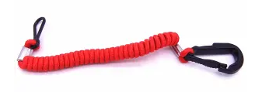
New Material to Cover in Class
Federal Law Change Effective: April 1, 2021
Recreational Boat Engine Cutoff Switch Requirements
Designed to reduce the potential of propeller injuries from runaway boats
Applies to recreational vessels under 26’
January 2023
Notes:
While statistics are not kept on deaths and injuries related to runaway boats (boats where the occupants are ejected from the vessel while the vessel has propulsion), the USCG has periodically analyzed their data and found dozens of deaths and injuries they believe could have been avoided through the use of engine cut off devices.
The hope is that increased placement of engine shut-off devices and continued education will lead more boaters to use these safety devices.
This will put more engine cut-off switches on more small craft, hopefully reducing deaths and injuries from “circle of death” incidents.
During the three years of 2018 to 2020, Congress passed two laws requiring, first, that manufacturers install engine cut-off switches on recreational vessels and, second, that recreational vessel operators use those engine cut-off switches. The laws that have placed these requirements on recreational vessel manufacturers and operators are found in the United States Code (USC), as opposed to the Code of Federal Regulations (CFR), where these requirements are typically found. These new laws will improve safety for all recreational boaters by reducing the potential for propeller injuries to recreational vessel operators, other users of the nation’s waterways, and marine law enforcement officers responsible for responding to runaway boats.
More specifically, Section 503 of the LoBiondo Coast Guard Authorization Act of 2018 created 46 USC 4312 to require a manufacturer, distributor, or dealer that installs propulsion machinery and associated starting controls on a covered recreational vessel (less than 26 feet long and capable of 115 pounds of static thrust) to equip the vessel with an ECOS per compliant with ABYC Standard A-33.
Section 8316 of the National Defense Authorization Act of 2021 amended 46 USC 4312 to require individuals operating those recreational vessels covered by the installation requirement to use ECOS links, except if the main helm is within an enclosed cabin or the vessel does not have and is not required to have an ECOS. It provides a penalty of $100, $250, and $500 for the first, second, and third offenses, respectively. The law went into effect on April 1, 2021. This requirement is referred to as the “use requirement.”

Slide 41
E-Directorate Contacts
Director: David Fuller
Deputy: Robert Brandenstein
Division Chief-Course Development: Gregory Fonzeno
Division Chief-Course Management: COMO Michael Morris
Division Chief-Communication Services: Dan Stroup
Division Chief-Instructor Development: Karen Miller
Division Chief-Special Projects: Andy Kelly
Contact info available in AuxDirectory
https://auxofficer.cgaux.org/auxoff/index.php
January 2023

Slide 42
Conclusion
Effective Auxiliary instructors are
Professional
Enthusiastic
Constantly practicing their craft
Our members and students deserve it!
January 2023
This Photo by Unknown Author is licensed under CC BY-NC
Notes:
Never lose the desire to improve. Whether you are an instructor in public education, member training, or engaged in mentoring in any of the flotilla missions, the satisfaction you and those you teach depends on the quality of your instruction.
Continue to practice and find ways to improve!

Slide 43
REMINDER
Submit your self-attestation form if you studied this workshop outside of a facilitated session.
January 2023

Slide 44
Thank You
If any questions, contact the appropriate E-Directorate Staff
following the Chain of Leadership and Management
You may email the E-Directorate at
pe.feedback@cgauxnet.us
January 2023
Notes:
It’s the policy of the CG Auxiliary that we solve issues at the lowest level. If the problem, question, or matter cannot be handled at this lower level, follow the Chain and press the issue higher.
All issues should be solved at the lowest possible level and elevated as needed through the chain of leadership and management to address the issue. It is NOT appropriate to go outside our organization for answers to education-related problems unless specifically instructed by the staff of the Education Directorate. Inquiries posed outside our organization confuse our partners and delay a proper response.
The entire staff of the E Directorate is standing by to answer any education questions that cannot be answered at a lower level.
The E-Directorate also maintains a feedback email address to assist members with answers they could not find anywhere else within the Auxiliary.
Members must understand that they are not to contact the Chief Director’s office or anyone outside the CG Auxiliary Chain of Leadership and Management. Any requests outside the Chain unnecessarily tie up resources answering these questions at BSX, NASBLA, and the BLA offices for internal Auxiliary queries. At the very least, it paints the Auxiliary as undisciplined and unable to communicate internally. At worst, it threatens our credibility at a national level with these national partners, which can have significant ramifications on future relationships.
You may email the E-Directorate at:
pe.feedback@cgauxnet.us

